Slide 1

POWER BI PROJECT
BLINKIT SALES ANALYSIS DASHBOARD
A comprehensive Power BI project analyzing sales performance, customer trends, and outlet insights to support data-driven business decision- making.
PREPARED BY
[Ganesh Chikne]
ROLE
Data Analyst
TOOL USED
Power BI

Slide 2

ABOUT BLINKIT & PROJECT PURPOSE
INTRODUCTION
Blinkit (formerly Grofers) is India's leading last-minute delivery app, promising grocery and essential deliveries in minutes. With rapid expansion across urban and semi-urban India, understanding sales performance is mission-critical.
ABOUT BLINKIT
Quick-commerce platform operating across Tier 1, 2 & 3 cities with multiple outlet types including grocery stores and supermarkets.
PROJECT OBJECTIVE
Build an interactive Power BI dashboard to analyze sales trends, identify top-performing outlets and item types, and generate actionable business insights.
PROBLEM STATEMENT
Understand which outlets, locations, and product categories drive the most revenue— and where improvement opportunities exist.

Slide 3




TOOLS, TECHNOLOGIES & DATASET OVERVIEW
TECH STACK
DATASET OVERVIEW
POWER BI
📦 Total Sales
🛍 Item Count
Interactive dashboards, slicers, and dynamic visualizations for end-to-end reporting.
Aggregated revenue across all outlets
8,523 unique product entries
MICROSOFT EXCEL
Raw data storage, initial exploration, and preprocessing before importing into Power BI.
🏪 Outlet Types
📂 Item Categories
Grocery Stores & Supermarket Types 1, 2, 3
Fruits, Snacks, Dairy, Frozen, Canned & more
DAX
Data Analysis Expressions used to build calculated columns, measures, and KPI formulas.
⭐ Ratings
Customer satisfaction score per item

Slide 4



DATA CLEANING, TRANSFORMATION & KEY KPIS
DATA PREPARATION STEPS
KEY KPIS AT A GLANCE
$1.20M
TOTAL SALES
$141
AVG. SALES
REMOVED NULL VALUES
Identified and eliminated missing or blank records to ensure data integrity across all columns.
Overall revenue generated across all outlets and categories
Average revenue per transaction
STANDARDIZED COLUMNS
8523
ITEMS
3.9
AVG. RATING
Unified naming conventions, corrected data types, and normalized categorical fields like outlet size and item fat content.
Total number of unique items in the dataset
Mean customer satisfaction score across all products
CALCULATED COLUMNS & MEASURES
Used DAX to create measures for Total Sales, Average Sales, Item Count, and Average Rating aggregations.

Slide 5
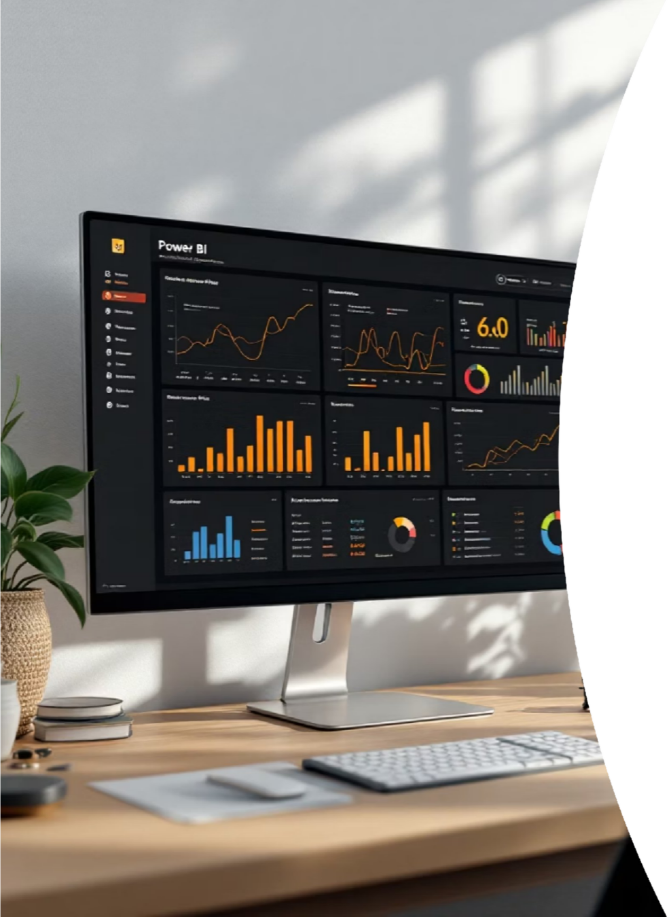




DASHBOARD OVERVIEW & INTERACTIVE FEATURES
DASHBOARD
The Power BI dashboard is designed for end-users to explore Blinkit's sales data dynamically. Three primary filter panels allow instant slicing of all visuals simultaneously.
OUTLET LOCATION FILTER
Toggle between Tier 1, Tier 2, and Tier 3 city outlets to compare geographic performance.
OUTLET SIZE FILTER
Filter by Small, Medium, or High (Large) outlet size to identify how store footprint affects sales.
ITEM TYPE FILTER
Drill down into specific product categories such as Fruits, Snacks, Dairy, or Frozen Foods.
All visuals are cross-filtered — selecting any slicer instantly updates every chart and KPI card on the dashboard in real time.

Slide 6




SALES ANALYSIS & ITEM TYPE BREAKDOWN
OUTLET ESTABLISHMENT TREND
Year-wise growth analysis reveals how Blinkit scaled its outlet network over time, highlighting peak expansion periods and market penetration milestones.
TOP SELLING ITEM CATEGORIES
FRUITS & VEGETABLES
Consistently the top-performing category, driven by high purchase frequency and repeat customers.
SNACK FOODS
Second highest contributor to total sales volume with strong impulse-buy behavior observed.
FAT CONTENT COMPARISON
Regular Fat items significantly outsell Low Fat alternatives, indicating customer preference trends that can inform inventory decisions.
EARLY LAUNCH
Initial outlets and pilot markets
MARKET MATURITY
Stabilized network and retention
RAPID EXPANSION
Aggressive city and SKU rollout
TIER 3 PUSH
Deepening reach into smaller towns
Outlets established in peak years contributed disproportionately to total sales, reflecting network-effect advantages.

Slide 7
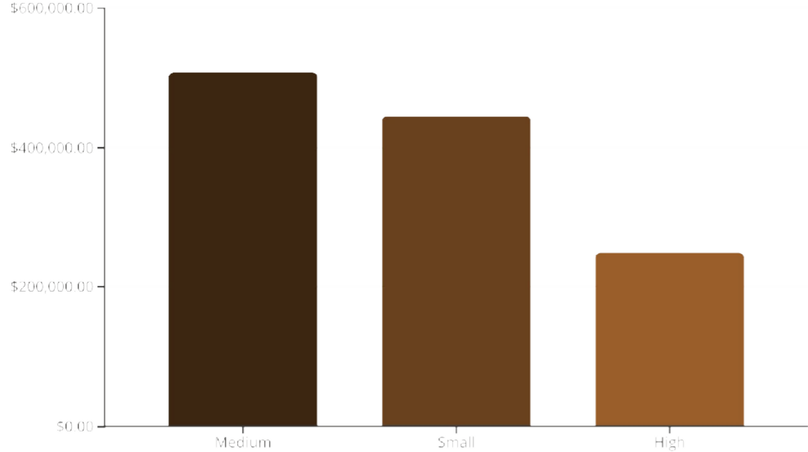
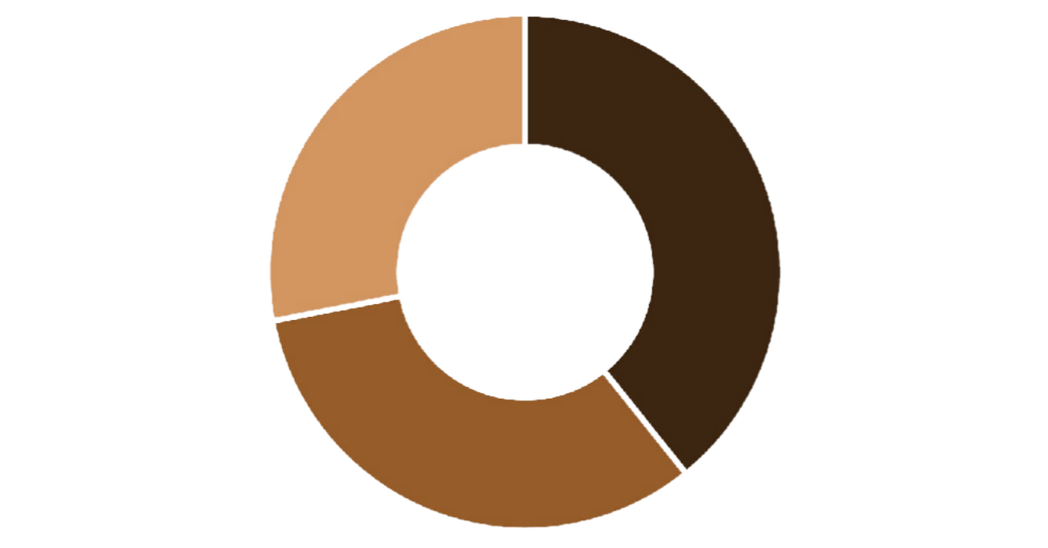



OUTLET & LOCATION ANALYSIS
SALES BY OUTLET SIZE
SALES BY OUTLET LOCATION TIER
Tier 3 Tier 2 Tier 1
Tier 3 locations surprisingly generate the highest share of total sales, pointing to underserved market demand in smaller cities.
Medium-sized outlets lead in total sales, suggesting optimal balance between inventory capacity and operational efficiency.

Slide 8

OUTLET TYPE COMPARISON
Comparing Grocery Stores vs. Supermarket Types across the three key performance dimensions: Sales, Item Count, and Ratings.
GROCERY STORE SUPERMARKET TYPE 1 SUPERMARKET TYPE 2 & 3
Lower total sales volume
Smaller item variety
Slightly higher avg. rating due to personalized service
Strong in Tier 3 neighborhoods
Highest total sales among all outlet types
Largest item count & product diversity
Wide footprint across all tiers
Dominant contributor to overall revenue
Moderate sales with niche product offerings
Higher avg. ratings compared to Type 1
Focused urban presence
Growth potential with targeted inventory
Supermarket Type 1 outperforms all other outlet types in both total sales and item count, making it the highest-priority segment for investment.

Slide 9

KEY INSIGHTS & BUSINESS RECOMMENDATIONS
Q Key Insights 💡 Recommendations
1
EXPAND IN TIER 3 CITIES
TIER 3 LEADS SALES
Outlets in Tier 3 cities generate the highest total revenue, revealing untapped demand in smaller urban markets.
Prioritize new outlet openings in Tier 3 locations to capitalize on high demand and low competition.
2
BOOST HIGH-PERFORMING CATEGORIES
MEDIUM SIZE WINS
Increase inventory depth in Fruits, Snacks, and Dairy to reduce stockouts and maximize revenue capture.
Medium-sized outlets consistently outperform small and high-capacity outlets in sales efficiency.
3
IMPROVE LOW-RATED PRODUCTS
CATEGORY DOMINANCE
Audit items with ratings below 3.5 and either improve quality, adjust pricing, or phase them out.
Fruits, Vegetables, and Snack Foods dominate sales, while Regular Fat items outsell Low Fat alternatives significantly.

Slide 10
CONCLUSION & THANK YOU
📊 Dashboard Impact
The Blinkit Power BI dashboard transforms raw sales data into clear, actionable insights — enabling faster, evidence-based decisions for outlet expansion, inventory planning, and customer satisfaction improvement.
o Summary of Findings
Tier 3 outlets and Medium-sized stores are the top revenue contributors. Supermarket Type 1 leads all outlet types. Fruits & Snacks dominate item sales. A focused strategy on these segments can significantly boost overall performance.
📬 Connect With Me
EMAIL
[your.email@example.com]
LINKEDIN
[linkedin.com/in/yourprofile]
GITHUB
[github.com/yourusername]
PHONE
[+91 XXXXX XXXXX]
Thank you for viewing this project! Open to Data Analyst opportunities — fresher, passionate, and results-driven. 🚀

